Slide 1
Branch and Bound for TSP
Project for Parallel Computation for Large - Scale Problems
Angelo Delli Santi
Giulia Grasso

Slide 2
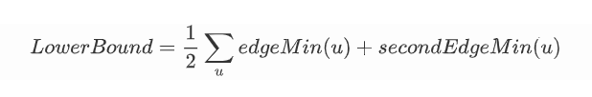
What are B&B and TSP
Main strategies:
Depth First;
Breadth First;
Best Bound First;

Slide 3
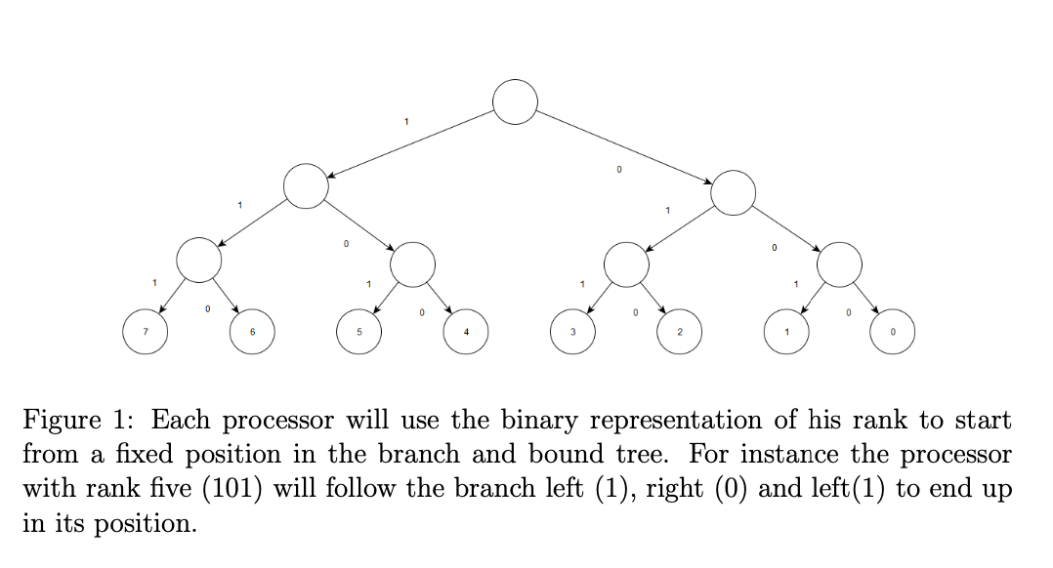
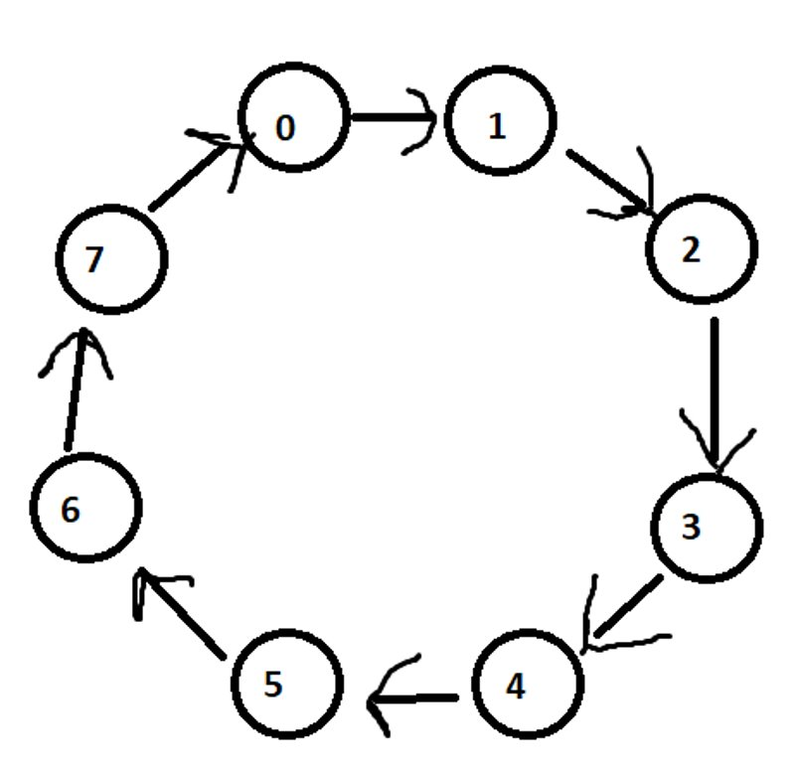
Parallel Version
Static distribution of the problems to the processors
Communication for exchanging the best solution
Adding communication for rebalancing the workload

Slide 4
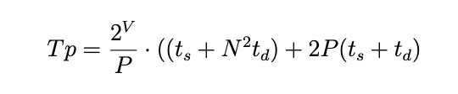
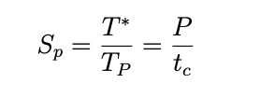
Complexity Analysis
Why theoretical analysis is not efficient
Speed-Up Anomalies

Slide 5
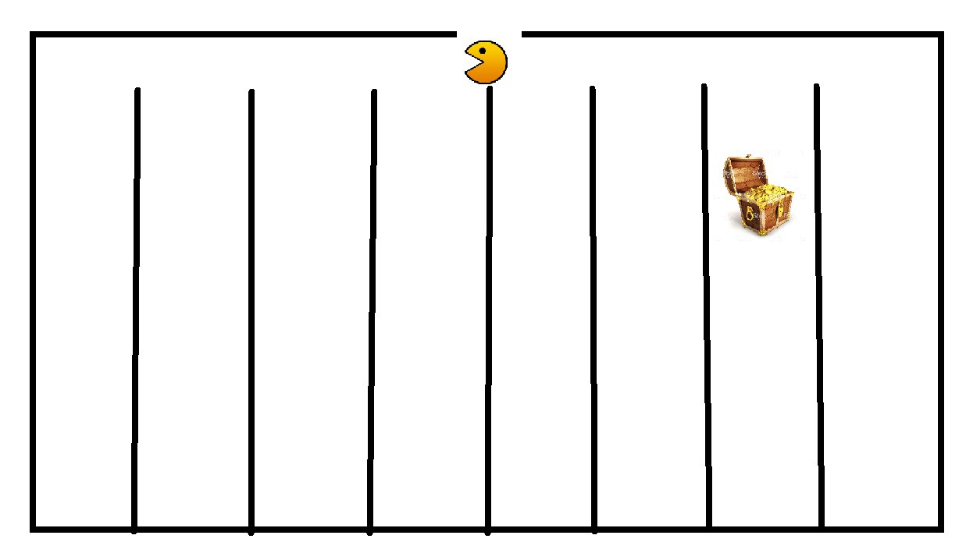
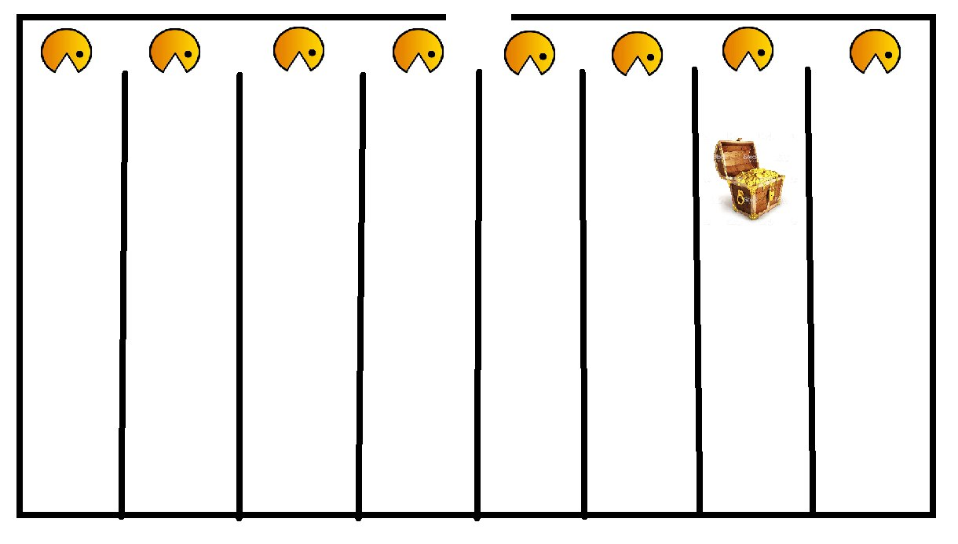
SpeedUp Anomalies

Slide 6
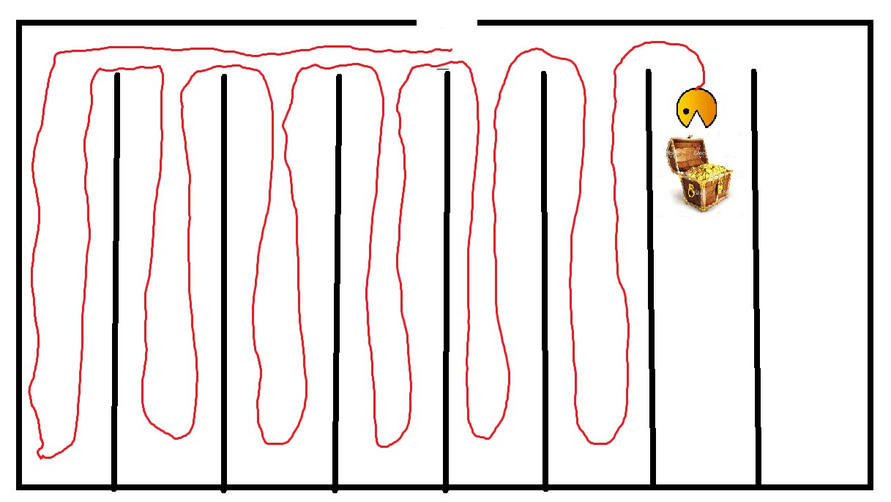
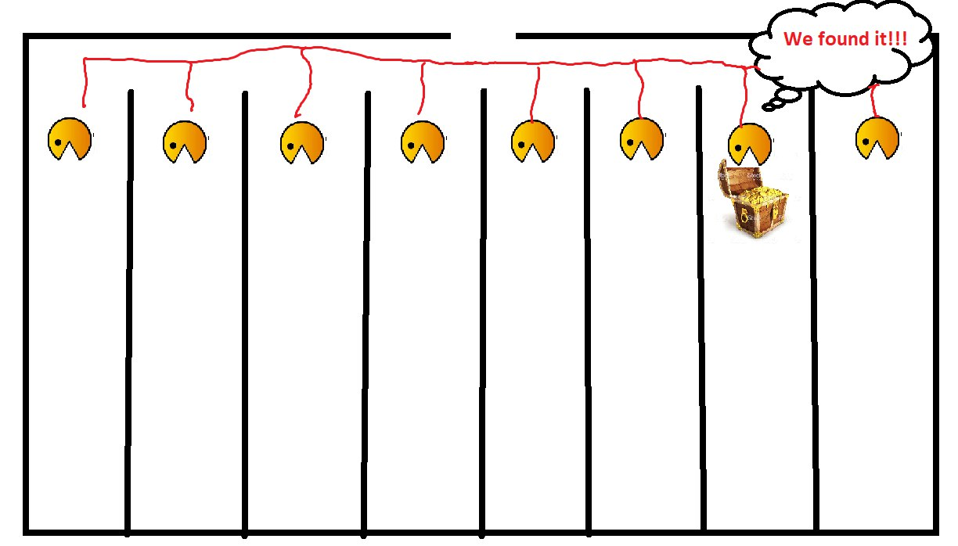
SpeedUp Anomalies

Slide 7
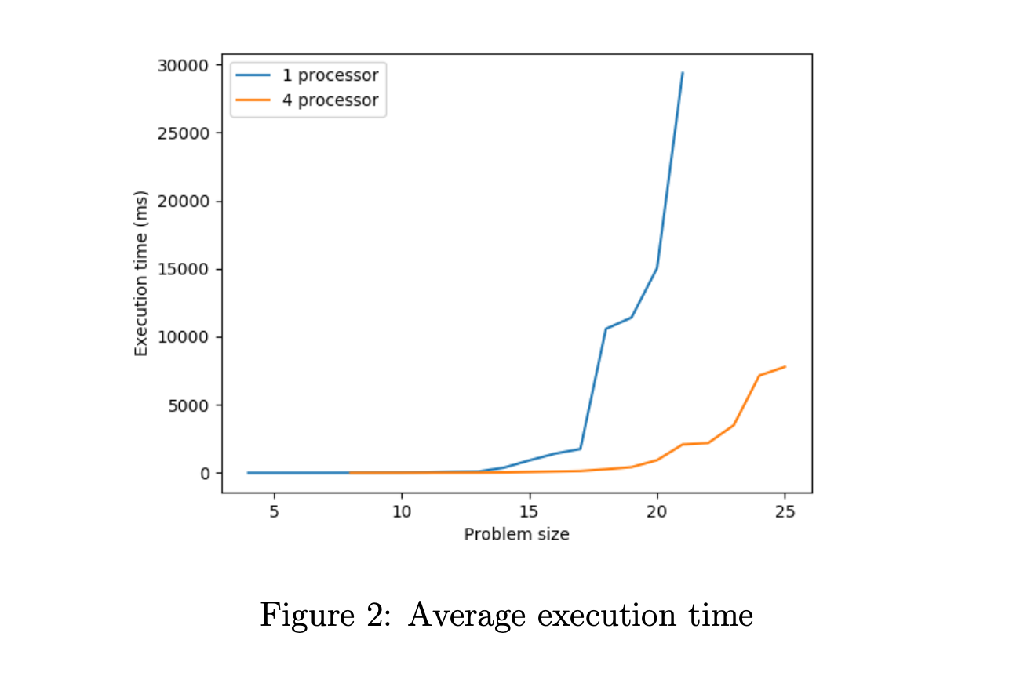
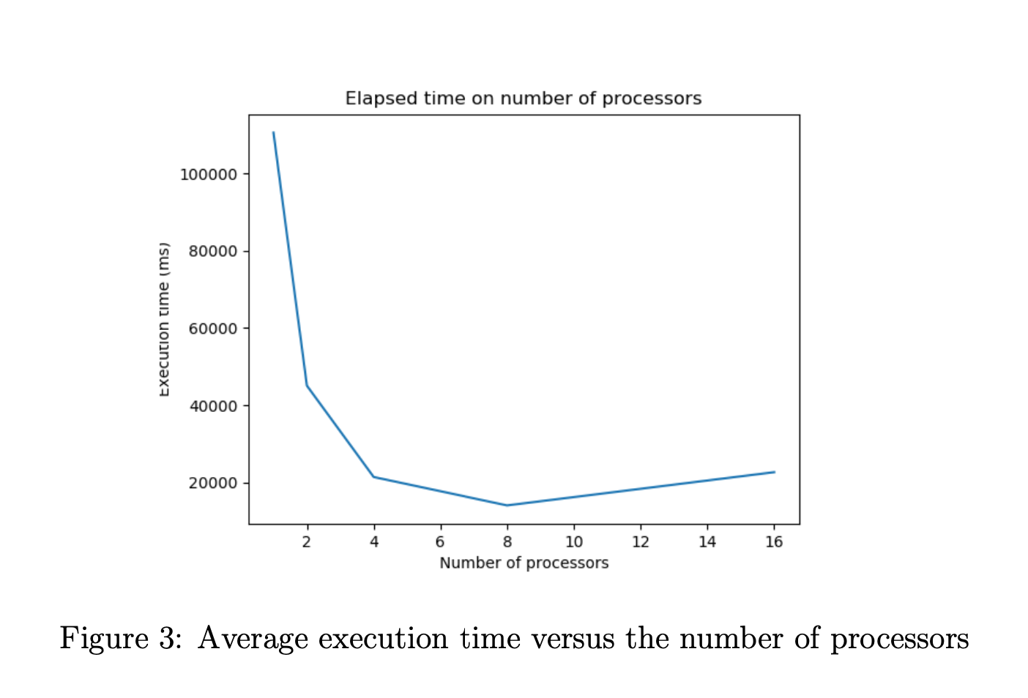
Experimental Results
Analysis Outcome

Slide 8
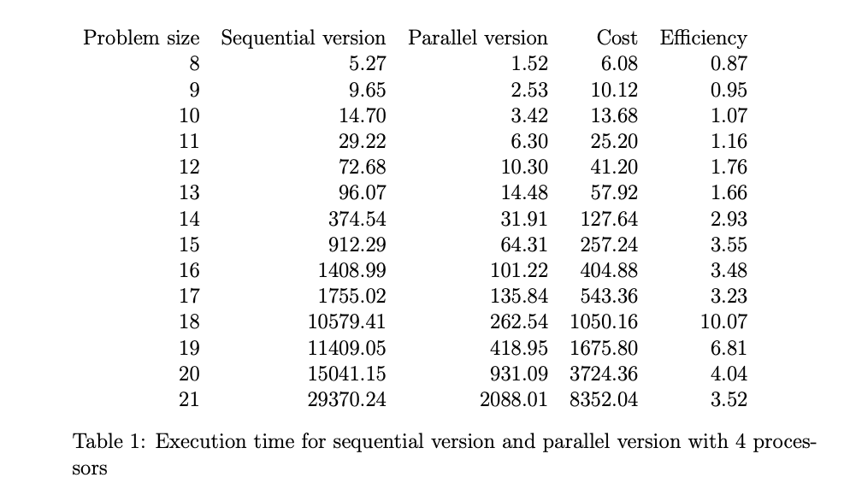
Summary and Conclusion
Results of our algorithm
Efficiency

Slide 9
Thank you for your attention!

